Slide 1
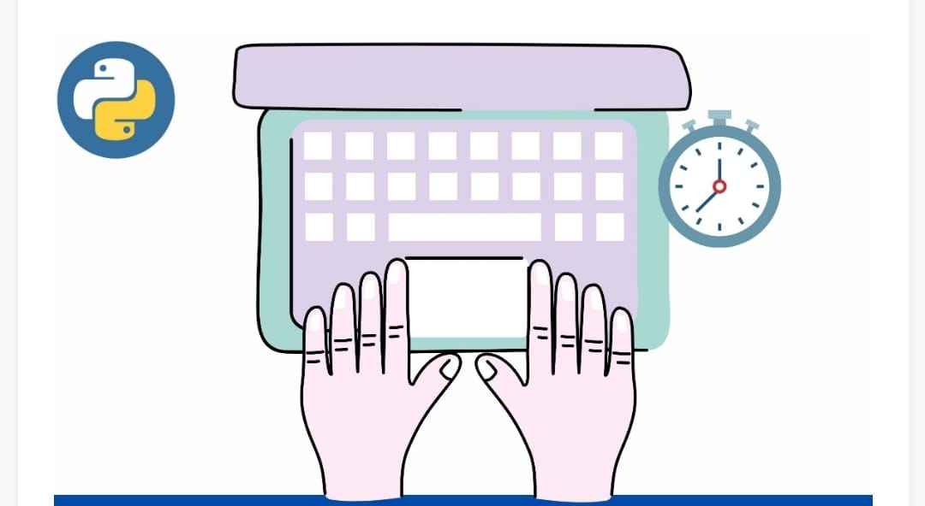
TYPING SPEED CALCULATOR USING PYTHON

Slide 2

BASAVESHWAR ENGINEERING College (AUTONOMOUS) BAGALKOt
DEPARTMENT OF ELECTRONICS AND COMMUNICATION
REPORT
Typinging speed calculator
Subject: Higher Programming Paradigm
Subject code : 21UEC308C
DIV: B
Presented By :
Name | USN | Roll no.
Arun Kumbar | 2BA21EC019 | 07
Prajwal Bidimani | 2BA21EC056 | 23
Faculty I/C: Dr. M.C.Aralimarad
Faculty Signature:___________________

Slide 3
BASAVESHWAR ENGINEERING College (AUTONOMOUS) BAGALKOt
DEPARTMENT OF ELECTRONICS AND COMMUNICATION
REPORT
Typinging speed calculator
Subject: Higher Programming Paradigm
Subject code : 21UEC308C
DIV: B
Presented By :
Name | USN | Roll no.
Arun Kumbar | 2BA21EC019 | 07
Prajwal Bidimani | 2BA21EC056 | 23
Faculty I/C: Dr. M.C.Aralimarad
Faculty Signature:___________________

Slide 4
INTRODUCTION
Typing speed is measured by the number of words you can type correctly in a set amount of time. A “word” is equivalent to five keystrokes. During a test, both speed and accuracy are measured. You will receive a number that indicates your average words per minute (WPM) and a percentage that indicates your accuracy.
A typing test is designed to find how fast one types in a given amount of time.

Slide 5
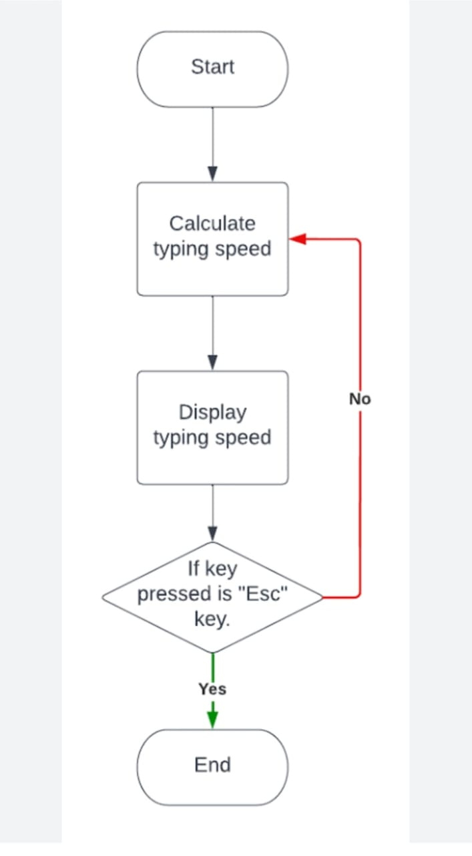
BLOCK DIAGRAM

Slide 6
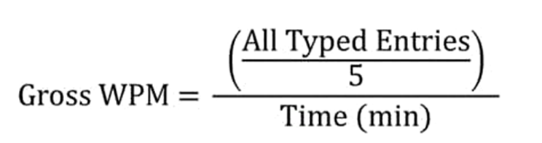
EXPLAINATION
The show_results() method is where we calculate the speed of the user's typing. The time starts when the user clicks on the input box and when the user hits return key “Enter” then we perform the difference and calculate time in seconds.
Typing is the process of writing or inputting text by pressing keys on a typewriter, computer keyboard, mobile phone or calculator. It can be distinguished from other means of text input, such as handwriting and speech recognition. Text can be in the form of letters, numbers and other symbols.

Slide 7
TYPING SPEED CALCULATOR SOURCE CODE
from time
import time
# calculate the accuracy of input prompt
def typingErrors(prompt):
global iwords
words = prompt.split()
errors = 0
for i in range(len(iwords)):
if i in (0, len(iwords)-1):
if iwords[i] == words[i]:
continue
else:
errors +=1
else:
errors += 1 return errors

Slide 8
# calculate the speed in words per minute def typingSpeed(iprompt, stime, etime): global time global iwords iwords = iprompt.split() twords = len(iwords) speed = twords / time return speed # calculate total time elapsed def timeElapsed(stime, etime): time = etime - stime return time

Slide 9
if __name__ == '__main__': prompt = "Hi, my name is Aman Kharwal, I am a coding instructor." print("Type this:- '", prompt, "'") # listening to input ENTER input("press ENTER when you are ready!") # recording time for input stime = time() iprompt = input() etime = time() # gather all the information returned from functions time = round(timeElapsed(stime, etime), 2) speed = typingSpeed(iprompt, stime, etime) errors = typingErrors(prompt) # printing all the required data print("Total Time elapsed : ", time, "s") print("Your Average Typing Speed was : ", speed, "words / minute") print("With a total of : ", errors, "errors")

Slide 10
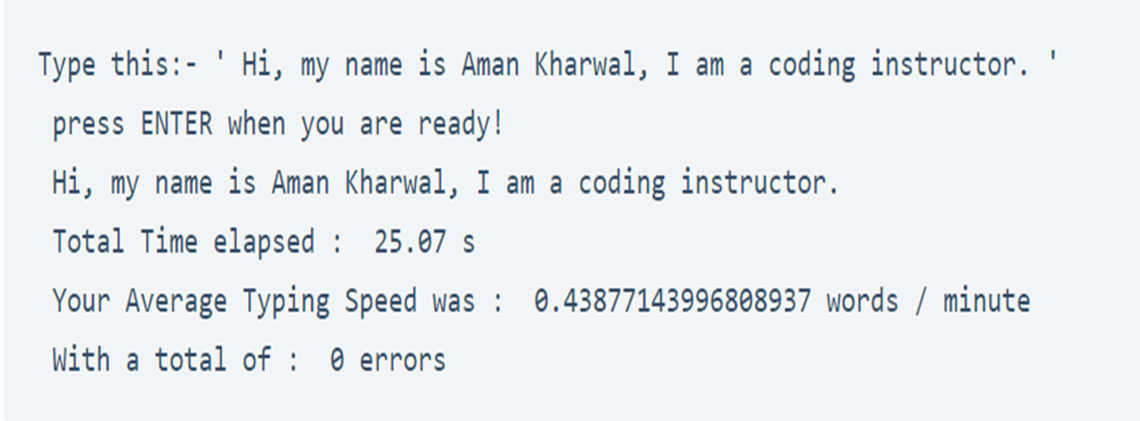
Output :

Slide 11
CONCLUSION
Taking a typing speed test establishes your average typing speed (WPM) and accuracy, which is an important baseline to know so you can increase speed and improve accuracy with practice. Periodically taking typing speed tests can help you track your progress and measure improvement.

